Slide 1
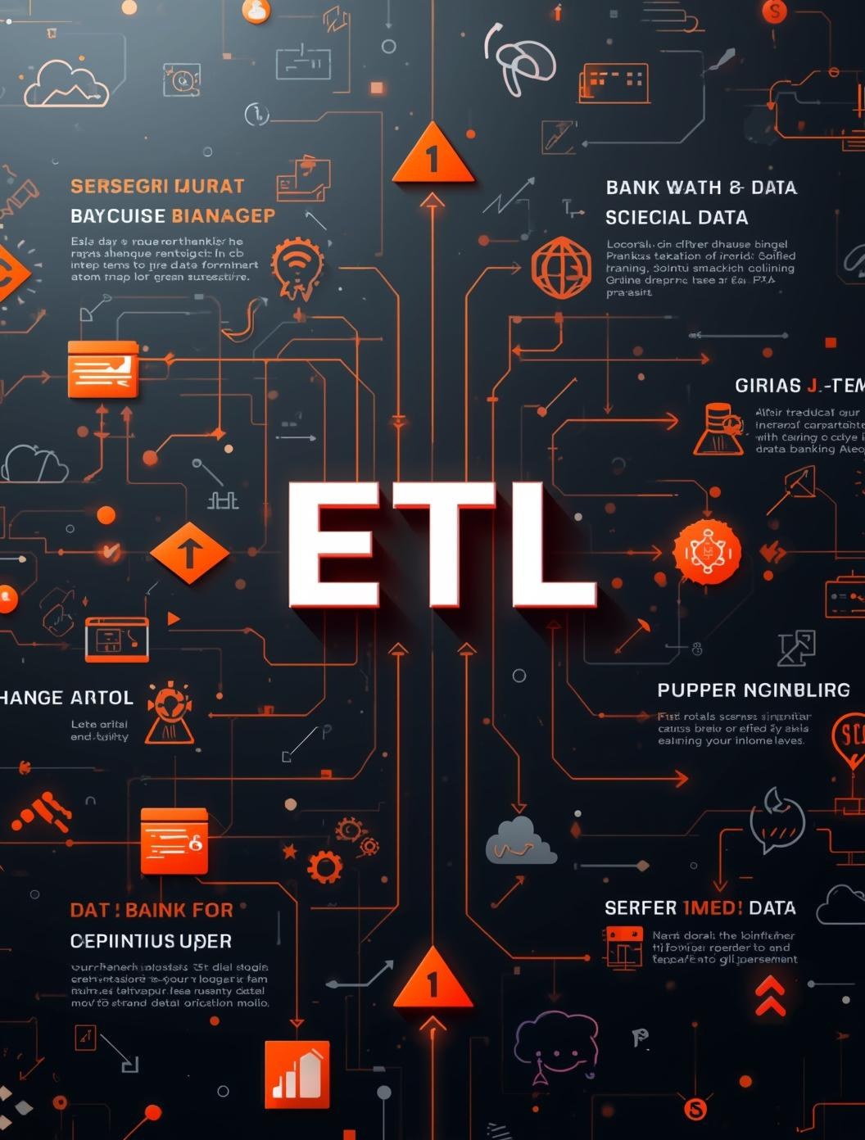

ETL Data Delivery
Presented by [name here]

Slide 2
Introduction
DELIVERING PERSONALIZED EXPERIENCES IN BANKING
ENHANCE ENGAGEMENT
INCREASE REVENUE
By providing tailored content through apps and SMS, banks can create meaningful connections with customers, fostering loyalty and enhancing overall engagement.
Personalized communications not only improve customer satisfaction but also lead to increased revenue, as clients are more likely to respond to targeted offers and services.

Slide 3

Data Delivery Overview

Slide 4
Data Delivery Methods
01
APP CONTENT
Engaging users through personalized app experiences.
02
SMS CONTENT
Instant updates and promotions via SMS delivery.
03
TARGETED OFFERS
Tailored promotions based on customer preferences.

Slide 5

Data Security in Delivery
PROTECTING CUSTOMER INFORMATION EFFECTIVELY

Slide 6

ETL Process Overview

Slide 7



Key ETL Steps
EXTRACTION, TRANSFORMATION, LOADING
Understanding ETL processes is crucial for effective data management and ensuring seamless integration of customer data across platforms.

Slide 8
Data Quality and Validation
ENSURING ACCURACY
MINIMIZING ERRORS
Ensuring data accuracy is crucial for effective decision-making and customer trust. Regular audits and validation processes help maintain data integrity and reduce discrepancies.
Implementing robust validation rules and automated checks can significantly minimize errors in data processing, leading to enhanced operational efficiency and better customer experiences.

Slide 9

Scalability and Performance
HIGH-CAPACITY SERVERS FOR DATA PROCESSING

Slide 10

Data Replication Techniques

Slide 11



Replication Techniques
METHODS FOR DATA SYNCHRONIZATION
Understanding replication techniques is crucial for maintaining data consistency and availability across multiple systems in retail banking environments.

Slide 12
Benefits of Data Replication
ENSURING RELIABILITY AND PERFORMANCE
DISASTER RECOVERY
IMPROVED PERFORMANCE
Data replication ensures rapid recovery during unexpected failures, minimizing downtime and providing a reliable backup to restore systems effectively and efficiently when needed.
By distributing data across multiple locations, replication enhances access speed and performance, allowing for quicker data retrieval and reducing latency for end-users.

Slide 13

Section 4: Data Integration

Slide 14



Integration Strategies
EFFECTIVE DATA MANAGEMENT
Utilizing data warehousing, data lakes, and APIs optimizes data storage, enhances accessibility, and ensures seamless integration across retail banking platforms.

Slide 15
Ensuring Data Consistency
STANDARDIZING DATA AND MANAGING CONFLICTS
STANDARDIZING DATA
MANAGING CONFLICTS
The process of standardizing data ensures consistent formats, allowing for seamless integration and analysis, which enhances reliability across all banking applications and systems.
Effective conflict management strategies are essential for maintaining data integrity, enabling swift resolution of discrepancies to preserve trust and accuracy in customer interactions.

Slide 16
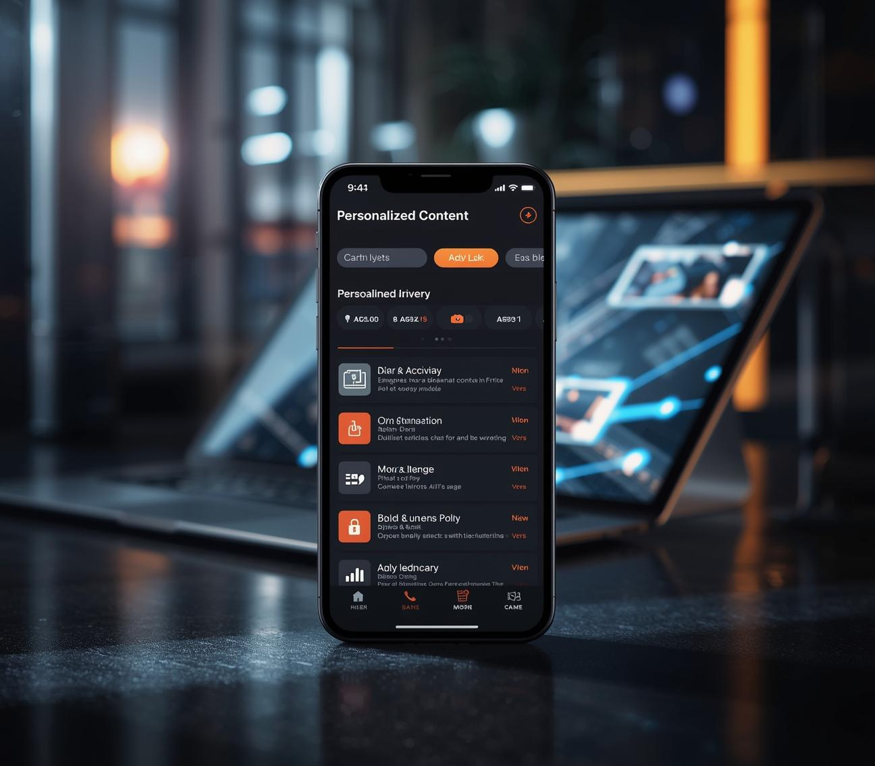
Personalized Content Delivery

Slide 17
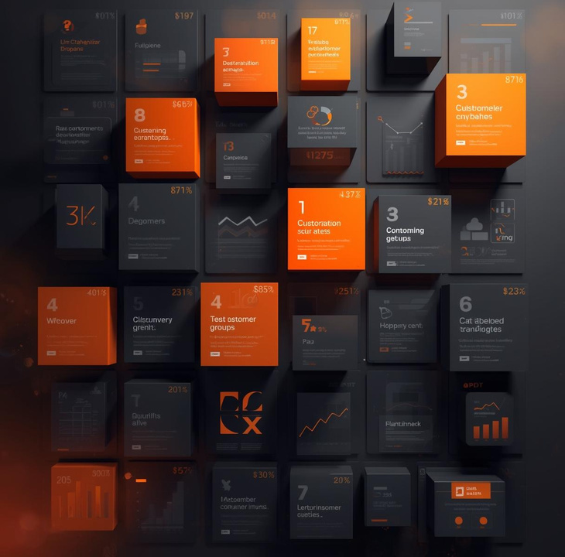

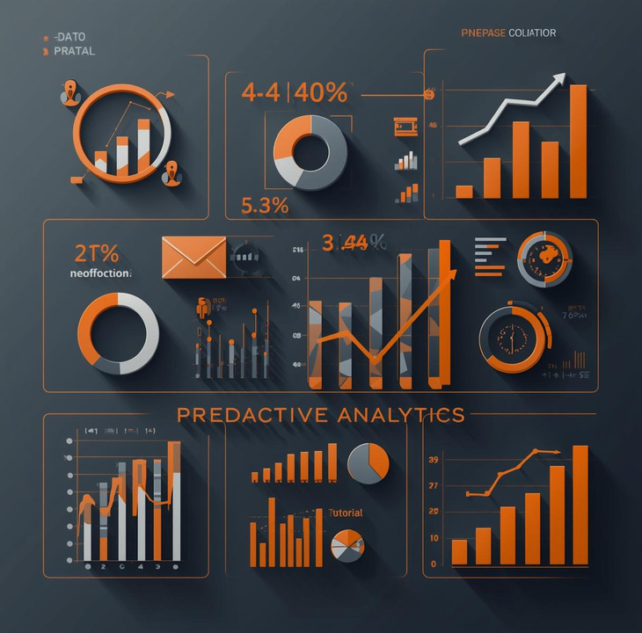
Personalization Techniques
TAILORED CUSTOMER EXPERIENCES
Utilizing segmentation, recommendation engines, and predictive analytics ensures personalized content delivery enhances customer engagement and satisfaction in retail banking.

Slide 18

Measuring Content Effectiveness
ANALYTICS DASHBOARD FOR PERFORMANCE INSIGHTS

Slide 19
Future Trends
EXPLORING INNOVATION IN DATA DELIVERY
AI-DRIVEN PERSONALIZATION
REAL-TIME ANALYTICS
Artificial intelligence can create tailored experiences for customers, analyzing behavior and preferences to deliver relevant content, enhancing engagement, and driving satisfaction levels.
Utilizing real-time analytics allows banks to rapidly process data, enabling immediate insights and timely adjustments to marketing strategies, ensuring responsiveness to customer needs.

Slide 20
Conclusion
ENHANCING CUSTOMER ENGAGEMENT AND GROWTH
CUSTOMER ENGAGEMENT
BUSINESS GROWTH
By leveraging personalized data delivery, banks can enhance customer engagement. Tailored content fosters stronger connections and increases customer satisfaction, leading to long-term loyalty.
Utilizing effective data integration strategies drives business growth in retail banking. Improved customer experiences and targeted marketing efforts translate into higher revenue and overall success.

